Slide 1


Studying Edge-On Sensor Alignment
Matteo Barbagiovanni
Sami Ullah Khan

Slide 2
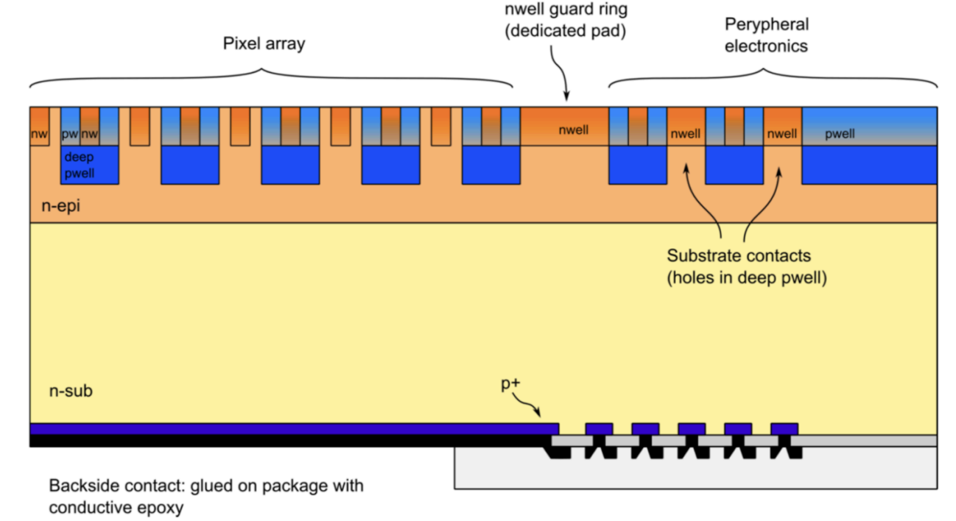
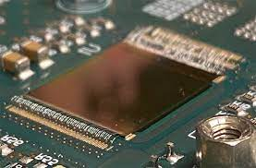
The ARCADIA project
ARCADIA Design Requirements
Pixel pitch [µm] 20 – 25
Thickness [µm] 50 – 500
Scalability [cm] Up to ~ 4x4
Hit rate 10 – 100
Timing resolution [ns] 10
Power consumption [mW/cm2] <10
Radiation hardness [Mrad] 1
Space driven requirements:
Power consumption reduction
Modular design (future design with stitching)
Low thickness
Designed for three different fields of applications:
Medical physics
High energy physics
Space applications

Slide 3
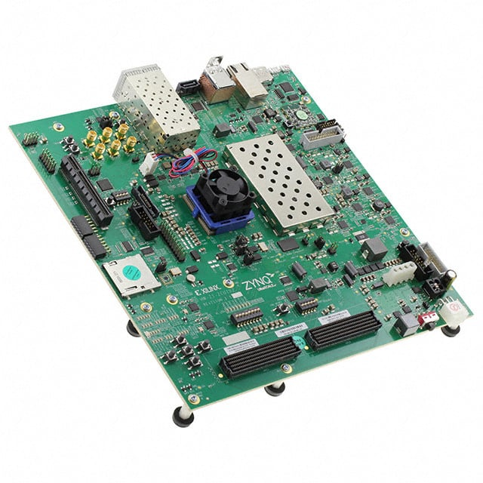
DAQ Platform: Zynq UltraScale+ MPSoC ZCU102
Used as the main DAQ control and processing board in our setup
Integrates both FPGA (for fast parallel data handling) and ARM processors (for control and communication)
Provides a flexible interface to connect custom ASICs and sensors through FMC connectors
Handles real-time data acquisition, event building, and transmission to the DAQ computer
Supports custom firmware and software development using Vivado and PetaLinux environments
Offers high-speed communication links (Ethernet, USB, PCIe) for data transfer and monitoring
Enables synchronized operation between front-end electronics and data recording system

Slide 4
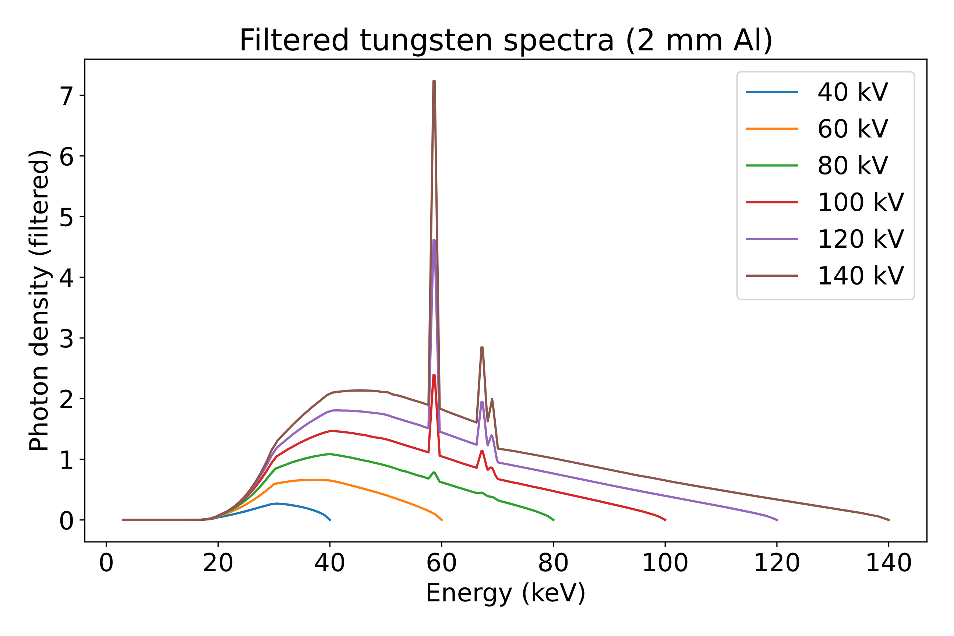
Activity Performed In X-ray Imaging lab November 5–7, 2025
The instrumentation used in our tests are part of the Laboratory of Archaeometry and Diagnostics for Cultural Heritage.

Slide 5
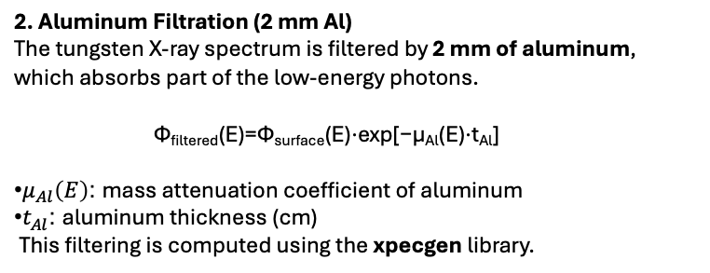
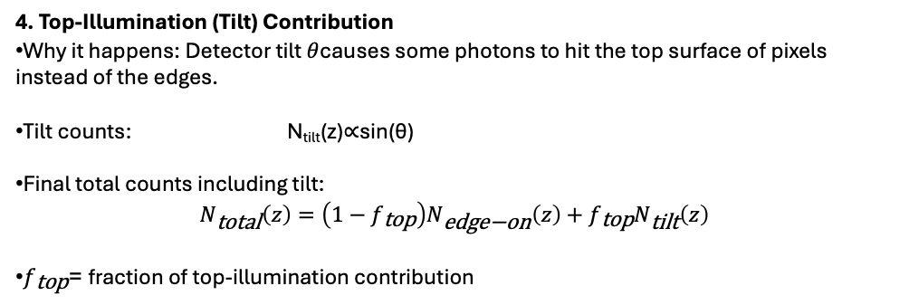
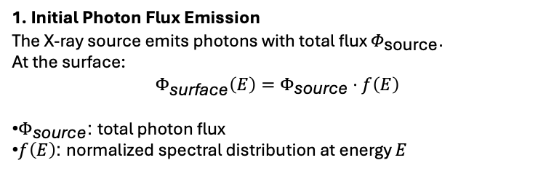
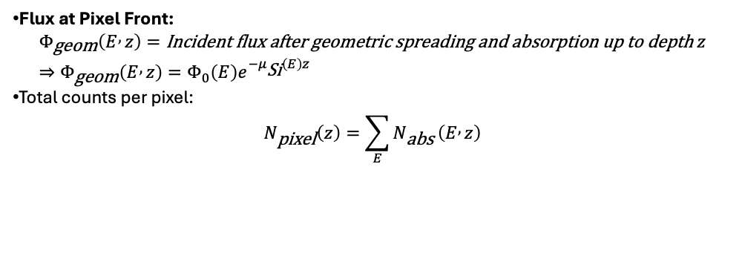
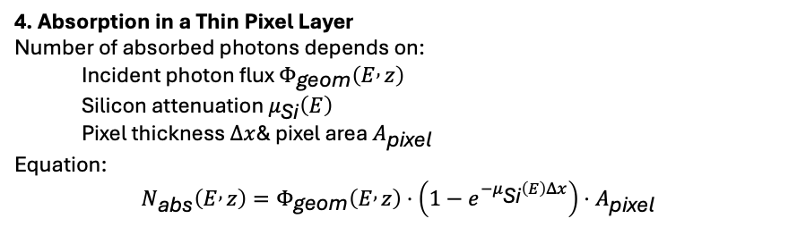
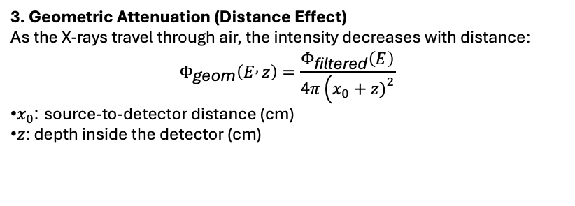
X-ray Detector Signal Modelling
1. Initial Photon Flux Emission
The X-ray source emits photons with total flux $Φ_{\text{source}}$. At the surface:
$$Φ_{\text{surface}}\left(E\right)=Φ_{\text{source}}⋅f\left(E\right)$$
$Φ_{\text{source}}$: total photon flux
$f\left(E\right)$: normalized spectral distribution at energy $E$
4. Absorption in a Thin Pixel Layer
Number of absorbed photons depends on:
Incident photon flux $Φ_{\text{geom}}\left(E , z\right)$
Silicon attenuation $μ_{\text{Si}}\left(E\right)$
Pixel thickness $Δx$& pixel area $A_{\text{pixel}}$
Equation:
$$N_{\text{abs}}\left(E , z\right)=Φ_{\text{geom}}\left(E , z\right)⋅\left(1−e^{−μ_{\text{Si}}\left(E\right)Δx}\right)⋅A_{\text{pixel}}$$
2. Aluminum Filtration (2 mm Al)
The tungsten X-ray spectrum is filtered by 2 mm of aluminum,
which absorbs part of the low-energy photons.
Φ_{filtered}​(E)=Φ_{surface​}(E)⋅exp[−μ_{Al}​(E)⋅t_{Al}​]
$μ_{Al}\left(E\right)$: mass attenuation coefficient of aluminum
$t_{Al}$: aluminum thickness (cm) This filtering is computed using the xpecgen library.
Flux at Pixel Front: $Φ_{\text{geom}}\left(E , z\right)=\text{Incident} \text{flux} \text{after} \text{geometric} \text{spreading} \text{and} \text{absorption} \text{up} \text{to} \text{depth} z$ $⇒Φ_{\text{geom}}\left(E , z\right)=Φ_{0}\left(E\right)e^{−μ_{\text{Si}}\left(E\right)z}$
Total counts per pixel:
$$N_{\text{pixel}}\left(z\right)=\sum_{E}{N_{\text{abs}}}\left(E , z\right)$$
4. Top-Illumination (Tilt) Contribution
Why it happens: Detector tilt $θ$causes some photons to hit the top surface of pixels instead of the edges.
Tilt counts: N_{tilt}​(z)∝sin(θ)
Final total counts including tilt:
$$N_{\text{total}}\left(z\right)=\left(1−f_{\text{top}}\right)N_{\text{edge}\text{−}\text{on}}\left(z\right)+f_{\text{top}}N_{\text{tilt}}\left(z\right)$$
$f_{\text{top}}$= fraction of top-illumination contribution
3. Geometric Attenuation (Distance Effect)
As the X-rays travel through air, the intensity decreases with distance: $$Φ_{\text{geom}}\left(E , z\right)=\frac{Φ_{\text{filtered}}\left(E\right)}{4π\left(x_{0}+z{\left.)\right.}^{2}\right.}$$
$x_{0}$: source-to-detector distance (cm)
$z$: depth inside the detector (cm)

Slide 6
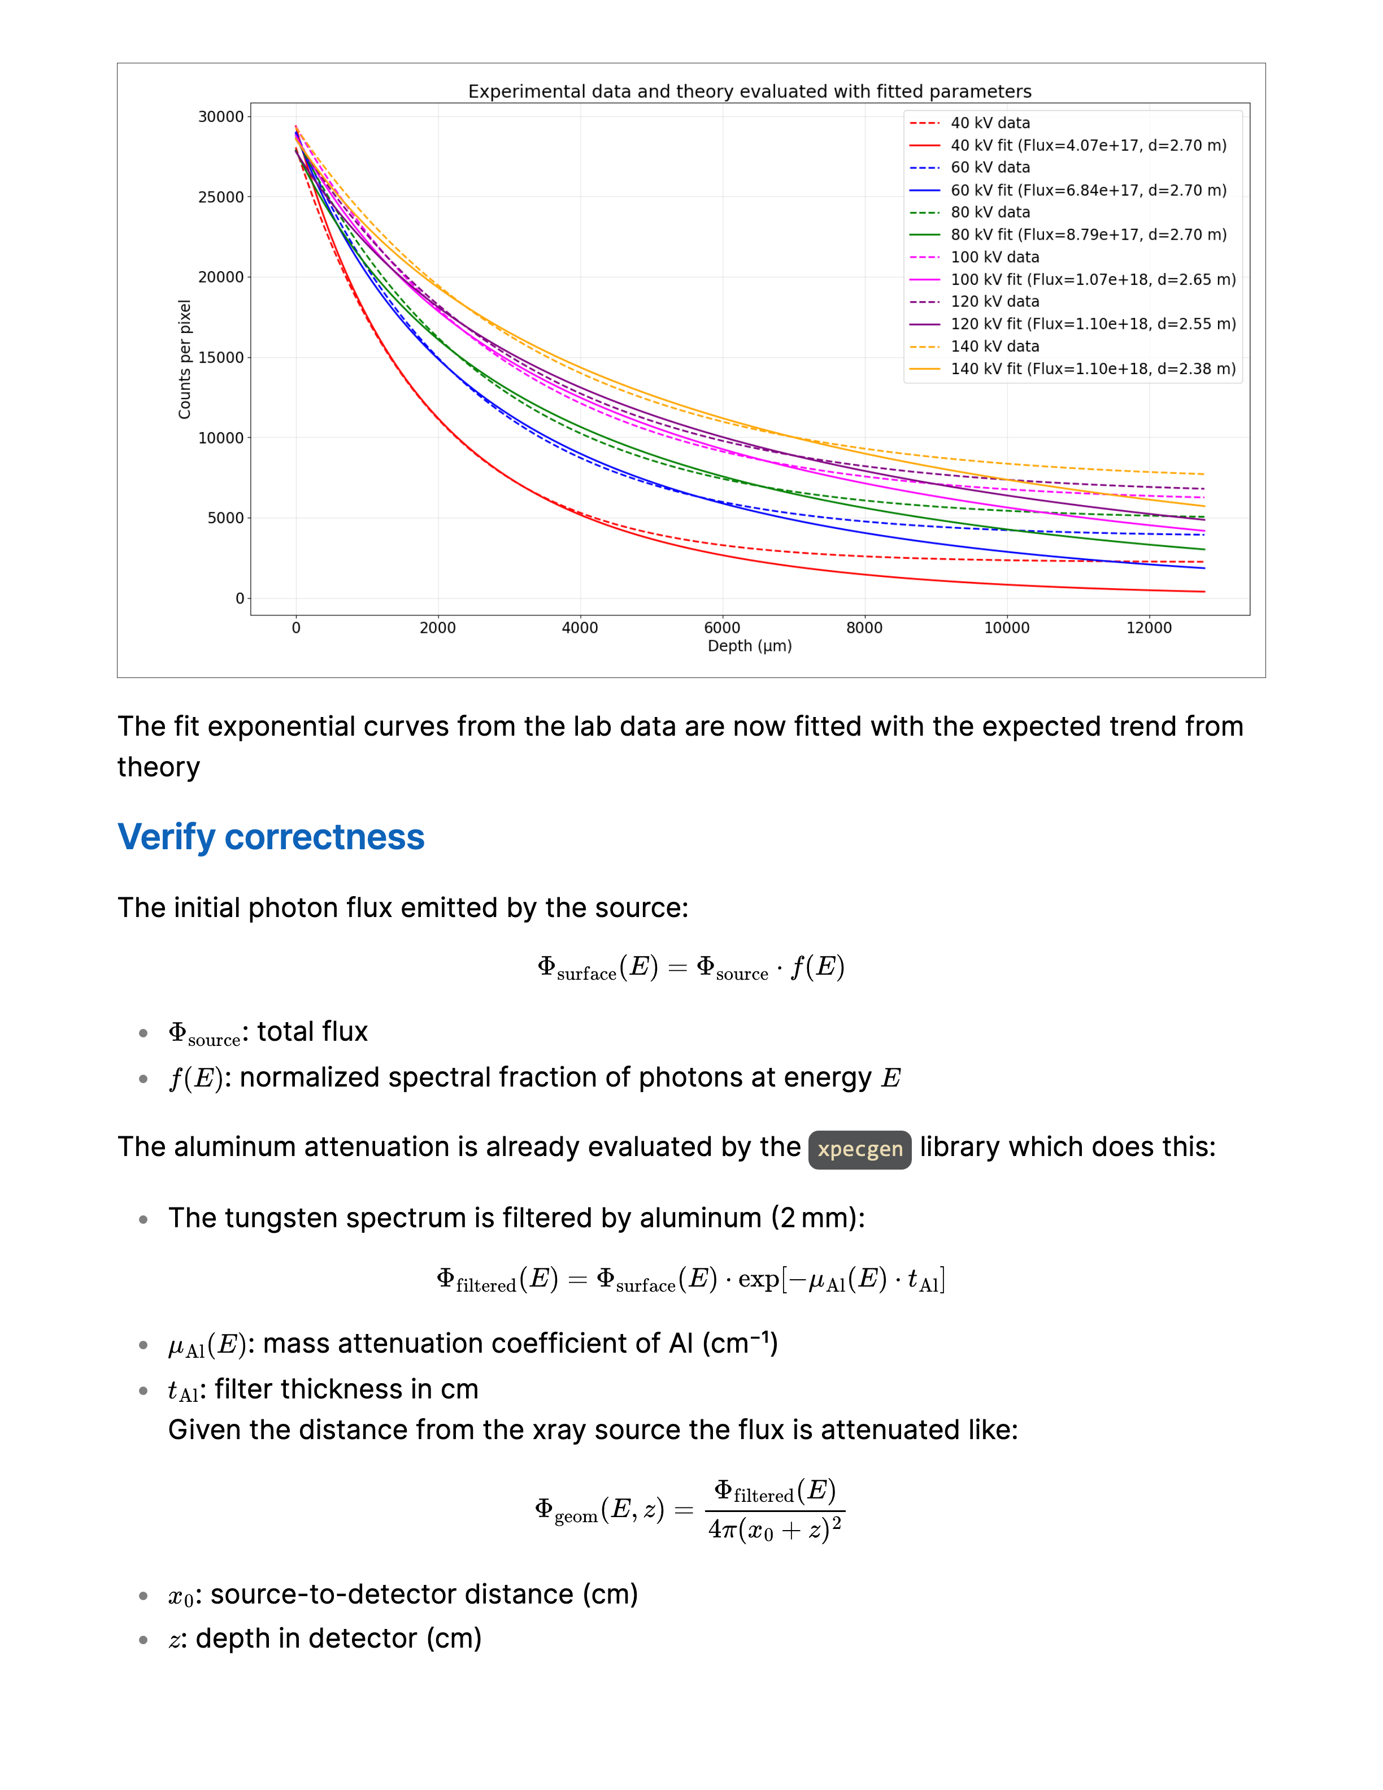
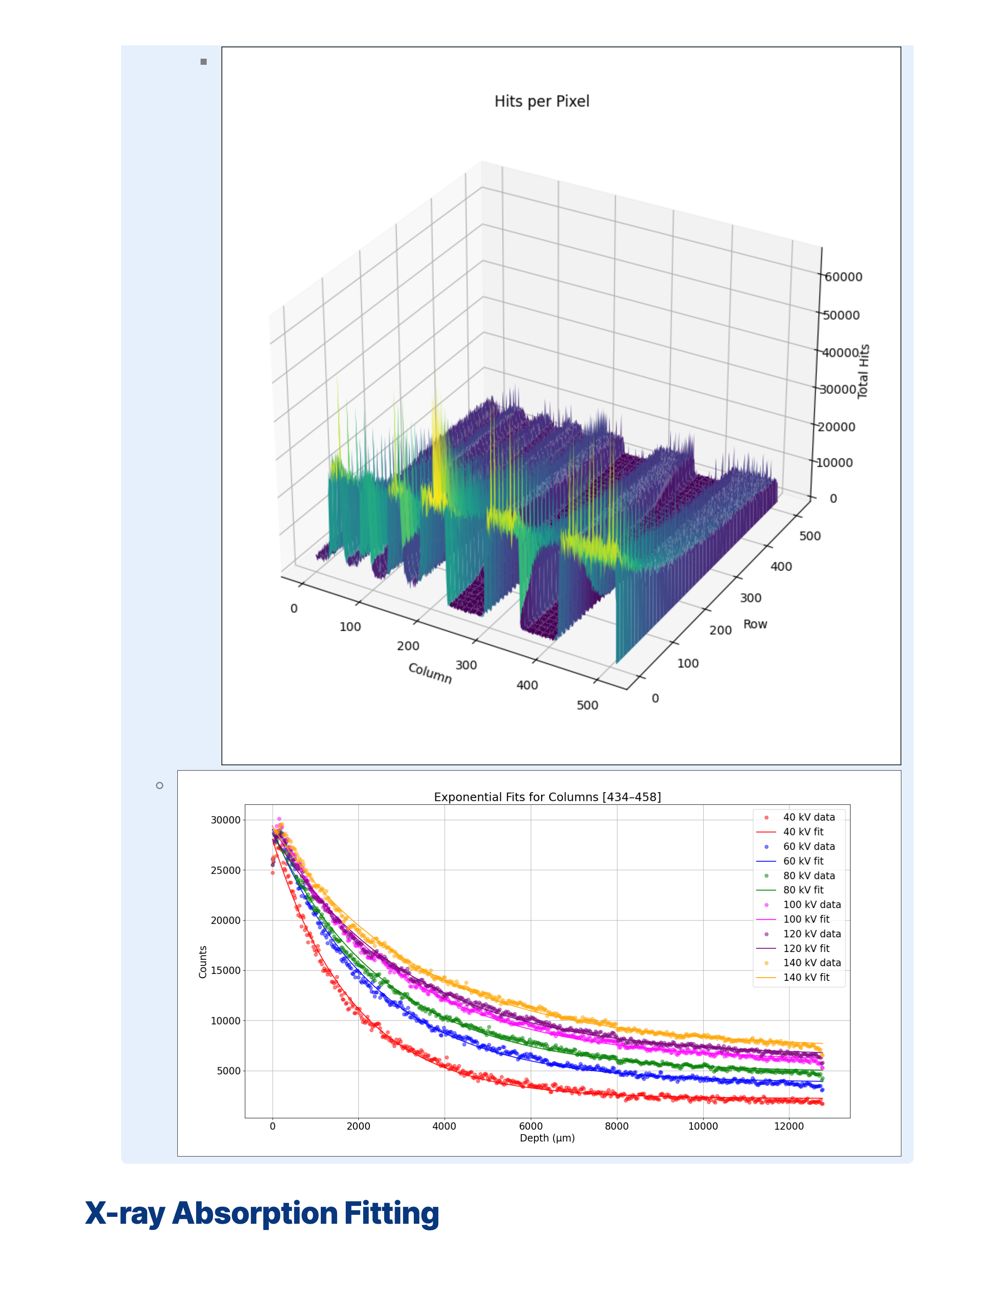
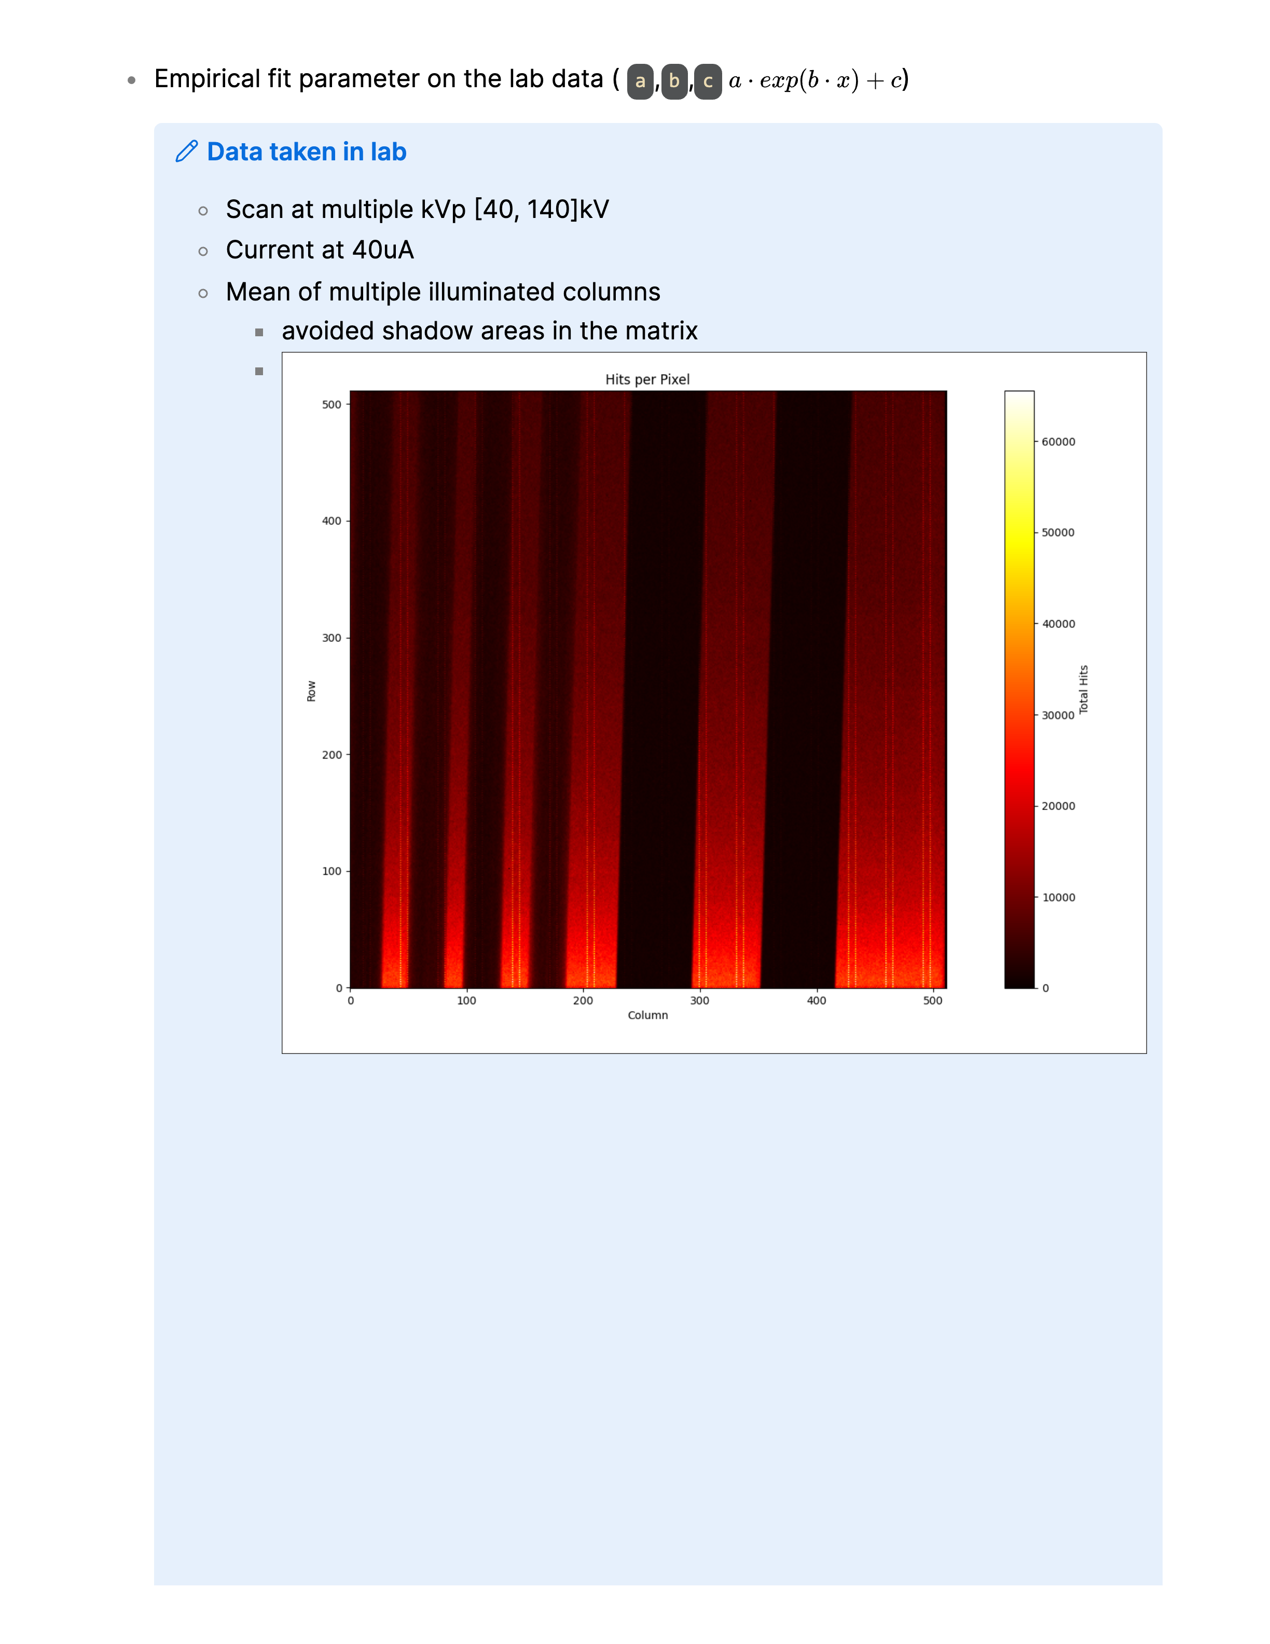
Acquisition Parameters and Data Processing
X-ray tube voltage (kV): Scans performed at multiple voltages ranging from 40 kV to 140 kV.
Tube current: Fixed at 40 µA for all acquisitions.
Data averaging: Mean signal calculated over multiple illuminated columns to improve signal-to-noise ratio.
Region selection: Shadowed areas were excluded from the matrix to ensure accurate intensity analysis.

Slide 7
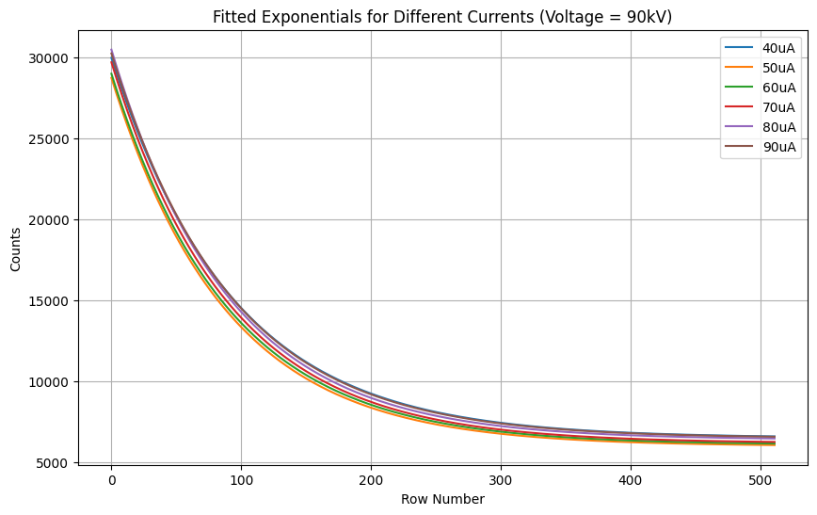
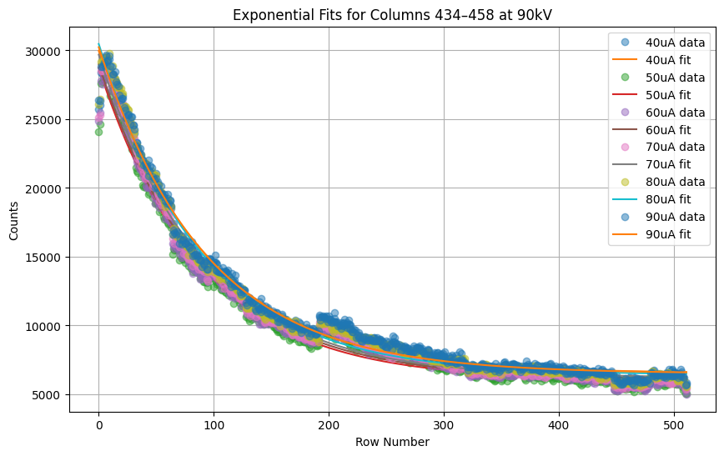
Acquisition performed on 06/11/2025
Board N08 – Data Acquisition at 90 kV Tube Current Varied from 50 µA to 90 µA Along the Sensor Edge
Currents µA | Voltages KV
50 | 90
60 | 90
70 | 90
80 | 90
90 | 90
The data was collected along the edge of the sensor to study how the detector responds in this region.
Counts were recorded for all rows and columns, and each measurement was repeated to ensure reliable results.

Slide 8

Acquisition performed on 07/11/2025
Configuration and Experimental Setup
Board N06 –
Configuration Details (CFG_ID = 3 and CFG_ID = 4)
CFG_ID = 3: Resistors configured as R9 = R14 = R11 = R13 to balance signal paths in the first block.
CFG_ID = 4: Resistors set as R3 = R5 = R4 = R8 in the second block to achieve uniform biasing across channels.

Slide 9
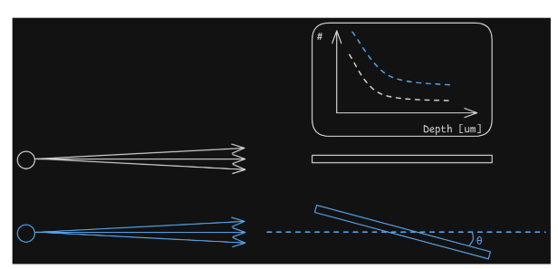
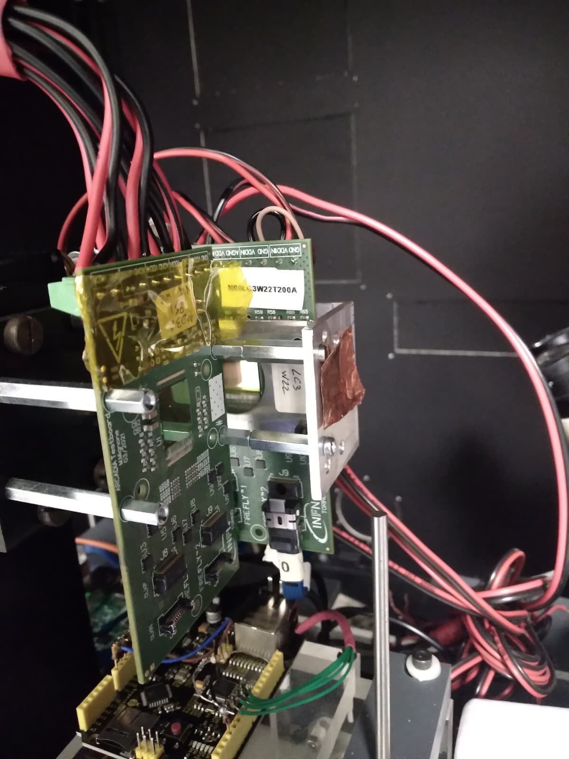
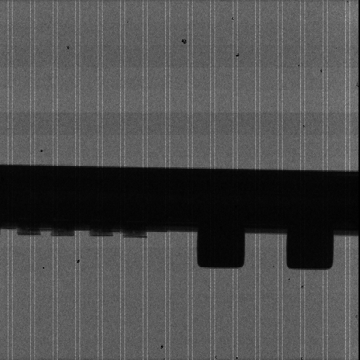
Alignment
N09 board detecting face-on.
N08 board edge-on, 150 kV, 66 𝜇A
First alignment try, the 4 resistors are shown, not the 4 in the back.
1 minute acquisition.

Slide 10
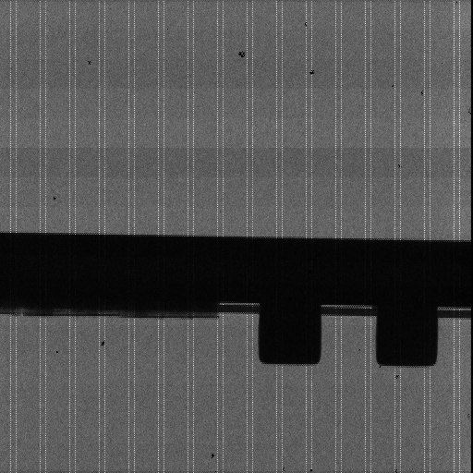
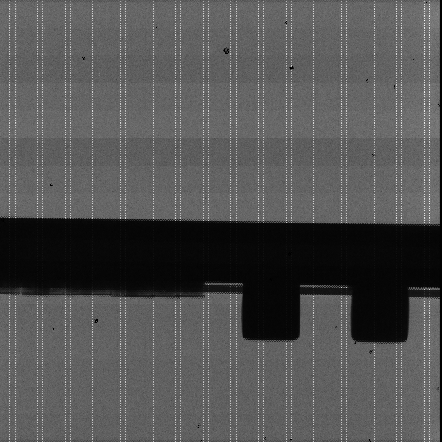
5 minutes acquisition of aligned board.
Right alignment, the resistor in the back are high as the ones in the front.
1 minute acquisition.
The chip is 8 ± 1 pixel thick (200 ± 25 𝜇𝑚 thick)

Slide 11
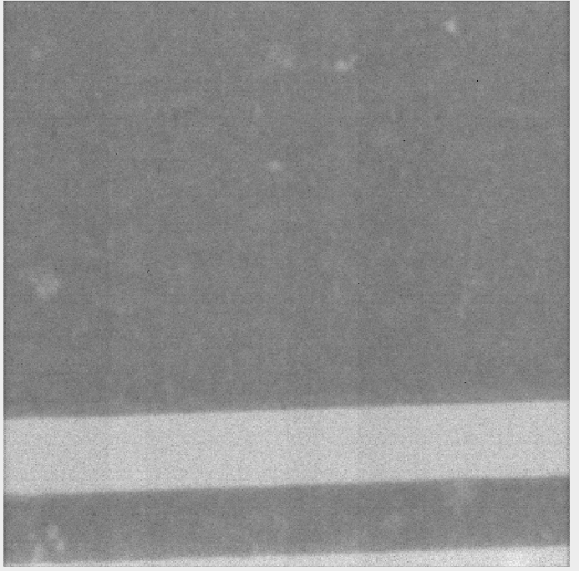
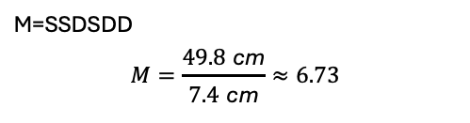
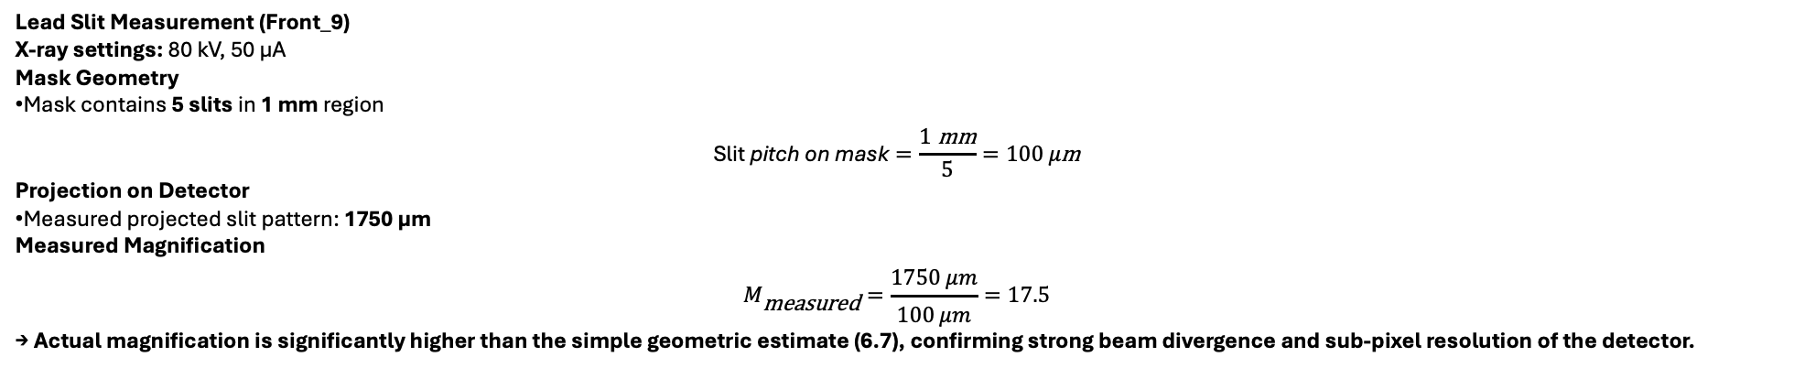
20 November — Magnification Study (Testboard N08)
Parameter | Value | Description
SSD (Source → Sample) | 7.4 cm | Lead mask positioned close to the X-ray tube
SDD (Source → Detector) | 49.8 cm | Detector placed downstream
Theoretical Magnification
M=SSDSDD​
$$M=\frac{49.8 \text{cm}}{7.4 \text{cm}}≈6.73$$
→ Features of the mask should appear ~6.7× larger on the detector.
Lead Slit Measurement (Front_9)
X-ray settings: 80 kV, 50 μA
Mask Geometry
Mask contains 5 slits in 1 mm region
$$\text{Slit} \text{pitch} \text{on} \text{mask}=\frac{1 \text{mm}}{5}=100 μ\text{m}$$
Projection on Detector
Measured projected slit pattern: 1750 μm
Measured Magnification
$$M_{\text{measured}}=\frac{1750 μm}{100 μm}=17.5$$
→ Actual magnification is significantly higher than the simple geometric estimate (6.7), confirming strong beam divergence and sub-pixel resolution of the detector.

Slide 13
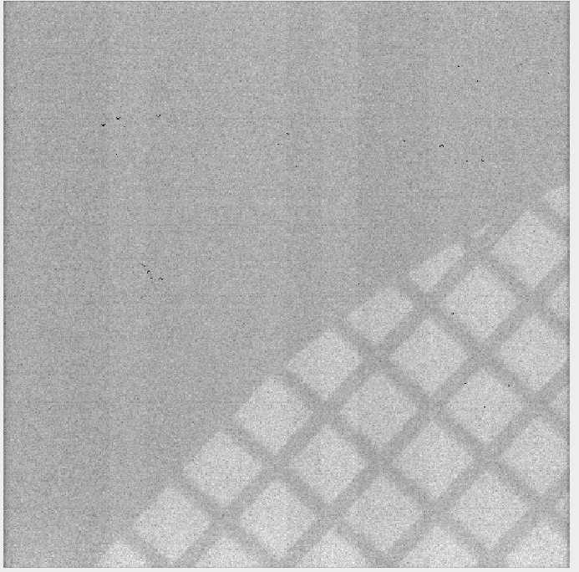
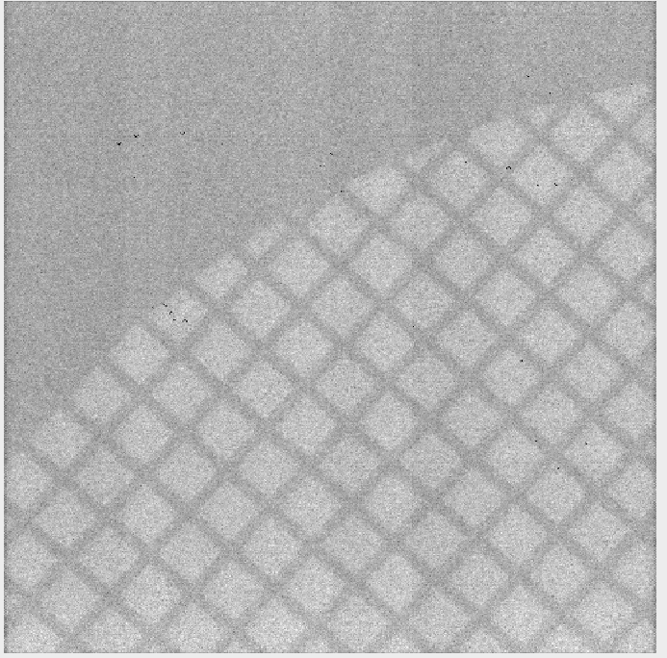
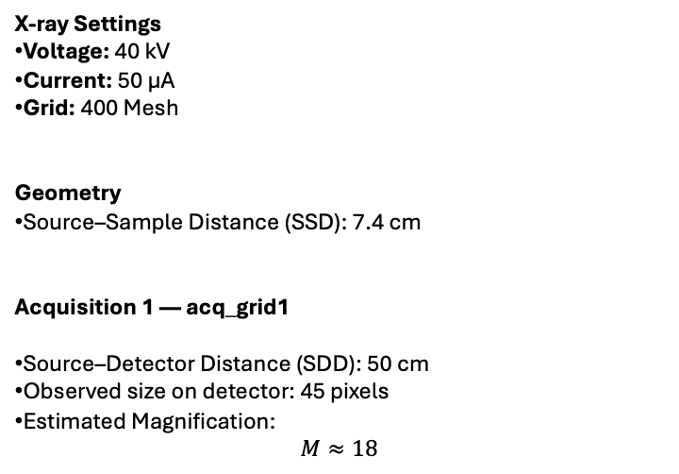
21 November — Magnification Measurements (400 Mesh Grid)
X-ray Settings
Voltage: 40 kV
Current: 50 μA
Grid: 400 Mesh
Geometry
Source–Sample Distance (SSD): 7.4 cm
Acquisition 1 — acq_grid1
Source–Detector Distance (SDD): 50 cm
Observed size on detector: 45 pixels
Estimated Magnification:
$$M≈18$$
Acquisition 2
Source–detector distance (SDD): 70 cm
Observed size on detector: 70 pixels
Magnification factor: ~27

Slide 14
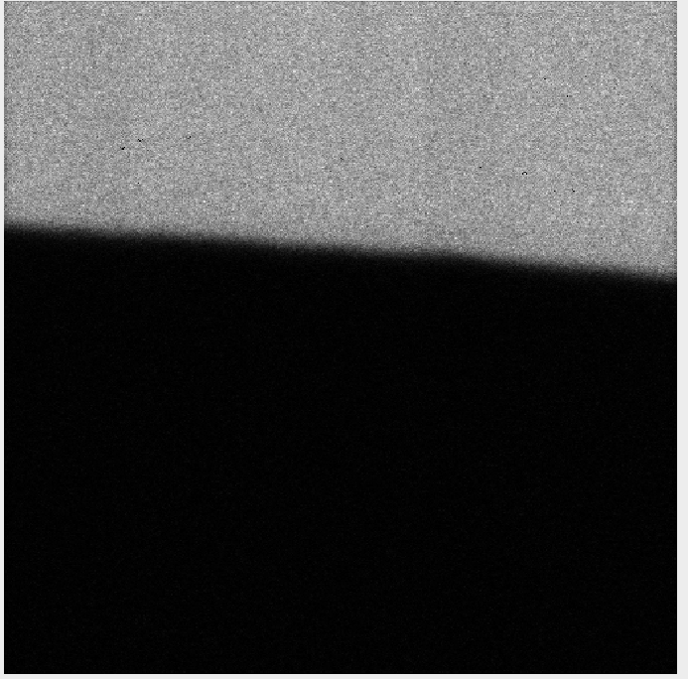
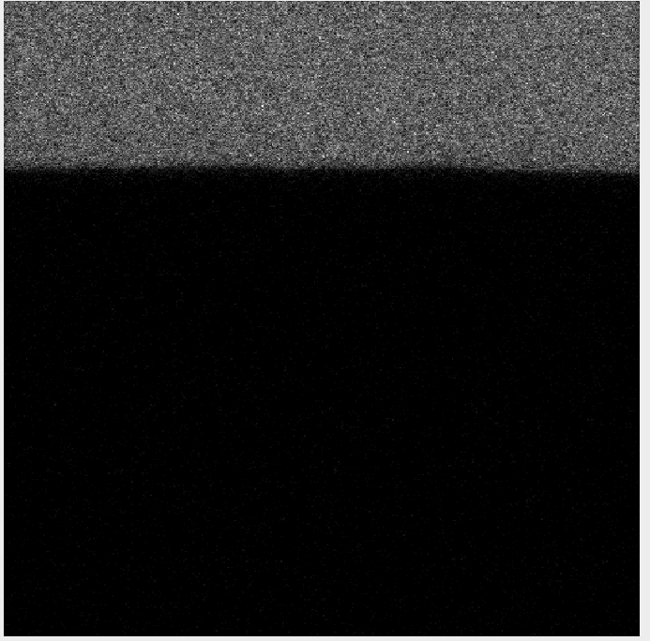
Acquisition 3 Tungsten
70 cm, 40 kV, 50 𝜇A
Acquisition 4 Tungsten
70 cm, 40 kV, 50 𝜇A

Slide 15
Focal Spot Study
X-ray Settings
Medium focal spot: 40 kV, 50 μA (Tungsten 10)
Test performed with 50% lead + 50% glass sample
Also tested small focal spot: 80 kV, 80 μA
Acquisition 17
Grid: Hamamatsu
Focus: Small
X-ray Settings: 80 kV, 80 μA
Source–Detector Distance (SDD): 81 cm
Source–Sample Distance (SSD): 8 cm
Acquisition 18
Same conditions as Acquisition 17
(Repeat measurement for stability)

Slide 16
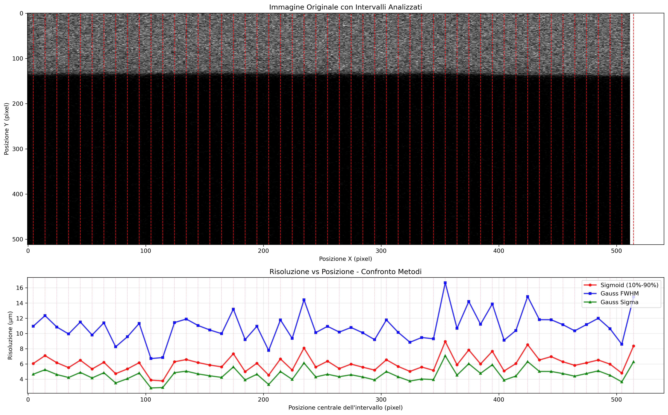
Resolution analysis on 10 pixels intervals

